Slide 1
Regional Organizing
Robin Purdy, Statewide Regional Coordinator

Slide 2
What Do You Know About Regional Organizing?
IDEA: We will work together to:
Meet the skill demands of industry sectors driving regional employment
Create opportunities for career pathways
Positively impact income mobility,
Improve communities of high poverty,
Grow the regional economy
Notes:
Have you heard about regional organizing?
Regional Organizing is based on the idea that organizing regional workforce partners to work together
to meet the skill demands of industry sectors that are driving regional employment
will create opportunities to move workers into career pathways
and positively impact income mobility, communities of high poverty and the regional economy.

Slide 3
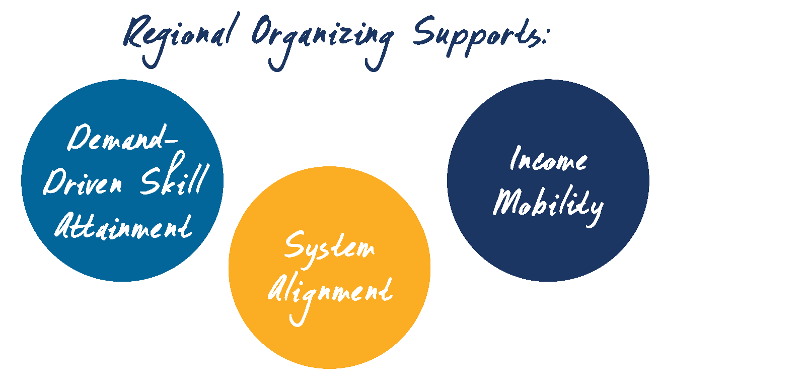
Regional Organizing Supports Implementation of California’s Strategic Workforce Plan
Notes:
To accomplish this, the Governor and State Board, as part of the California Strategic Workforce Plan, designated fourteen regional planning units (RPU’s). The Local Workforce Boards that comprise each of the planning units are organizing regionally and have developed regional plans that address the major objectives of the State Plan:
Which are:
demand-driven skill attainment through regional career pathway programs
achieving income mobility for individuals with barriers to employment, and
system alignment among regionally organized Local Boards and their partners.

Slide 4
The California Strategic Plan
PRIORITIES
HOW
Regional coordination among key partners
Sector-based employment strategies
Development of career pathways
Income mobility through skill attainment
Positive impact on individuals with barriers, communities of high poverty and regional economies
COLLABORATION among partners in the development of service delivery strategies and alignment of resources
INNOVATION that creates, adapts, & accelerates promising practices in workforce development and skill attainment
SYSTEM CHANGE by adopting proven strategies and innovations
Notes:
The objective of regional organizing is to organize partners, systems, resources, effective approaches, and leadership to achieve scale and impact through collaboration, innovation and system change by prioritizing regional coordination, sector based employment strategies, career pathways and income mobility.
The exact manner in which these partnerships come together varies from region to region based on the unique set of circumstances that shape each region’s workforce needs.
In order to support local workforce Board’s efforts to organize the regions, the State is investing in professional development/ training of the workforce system staff and partners, regional advocacy, and Regional Organizers tasked with focusing on implementation of the goals and objectives contained in the regional plans.

Slide 5
Regional Plan Implementation through Regional Organizing
Notes:
This a big challenge and change….how do you get there?
It started with California Workforce Development Board’s investments in SlingShot, Workforce Accelerator, High Road Training Program, and development of the State’s Strategic Workforce Plan and Regional Workforce Plans. Sling Shot brought regional workforce leaders together to identify and solve employment challenges that slow California’s economic engine. Workforce Accelerators create and prototype innovative strategies that bridge education and workforce gaps for targeted populations. High Road Training Programs support skill-focused, industry-based projects that explore challenges of job quality, economic opportunity and environmental sustainability. These initiatives, combined with investments which enabled regionally organized local boards to develop regional plans, regional training coordinators to develop professional development opportunities for workforce staff and partners, and regional organizers to add capacity necessary to implement the goals and objectives contained in the regional plans, create the infrastructure to implement the State’s Workforce Plan.

Slide 6
What Does the Regional Work Look Like?
Regional Organizing includes:
Building regional coalitions and developing models for sustaining regional leadership
Enhancing industry/employer/partner engagement.
Developing innovative approaches to preparing individuals with barriers in sectors in demand in the regional economy
Enriching the service delivery methods being provided through the local America’s Job Center of California (AJCC) system.
Aligning Regional Plan goals with existing State Board investments
Notes:
What are they doing?
Here are some examples of the type of work that’s being done in the regions:
1. Aligning regional goals with existing investments made by the State Board and other State partners. Ex:
East Bay: environmental scan of Workforce Accelerator investments to expand and scale successful partnerships
SlingShot
Strong Workforce – Middle Sierra working with college, K-12 and econ dev
Building regional coalitions and models for regional leadership
Capital and Coastal – identifying or developing non-profit intermediary for coordinating regional work
North Bay, Inland Empire and San Joaquin Valley – developing MOU’s laying out regional cooperation agreements
Enhancing engagement by industry/employers/labor partner
North Coast – developing construction sector strategy career pathway with education, industry and labor
LA Basin – Healthcare, Aerospace and Transportation/Logistics sector strategies
Inland Empire – transportation/log and manufacturing– Orange – Manufacturng, ICT, Hospitality and Healthcare
East Bay & Bay Peninsula
Ventura and Capital and Bay Peninsual working on models of unitifed approach to business
4. Innovative Approaches to working with individuals with barriers to employment
LA Basin and North State – Disconnected Youth
LA Basin – criminal justice system
Middle Sierra – non-custodial parents
5. AJCC system improvements: San Joaquin, Southern Border

Slide 7
Who’s Doing This Work?
Vision, Support, Resources from
Governor and Labor & Workforce Development Agency
California Workforce Development Board
EDD and other State Planning Partners
Regionally organized Local Workforce Development Boards
Regional Education, Workforce Development and Economic Development Partners
Business/Industry Leaders
Community Leaders and Elected Officials
On-the-Ground efforts by
Local Workforce Leadership (local boards and partners)
Regional partners (industry, education, community)
Regional Organizers
Regional Training Coordinators
California Workforce Development Board Staff
EDD Regional Advisors
California Workforce Association
Notes:
What are they doing?
Here are some examples of the type of work that’s being done in the regions:
1. Aligning regional goals with existing investments made by the State Board and other State partners. Ex:
East Bay: environmental scan of Workforce Accelerator investments to expand and scale successful partnerships
SlingShot
Strong Workforce – Middle Sierra working with college, K-12 and econ dev
Building regional coalitions and models for regional leadership
Capital and Coastal – identifying or developing non-profit intermediary for coordinating regional work
North Bay, Inland Empire and San Joaquin Valley – developing MOU’s laying out regional cooperation agreements
Enhancing engagement by industry/employers/labor partner
North Coast – developing construction sector strategy career pathway with education, industry and labor
LA Basin – Healthcare, Aerospace and Transportation/Logistics sector strategies
Inland Empire – transportation/log and manufacturing– Orange – Manufacturng, ICT, Hospitality and Healthcare
East Bay & Bay Peninsula
Ventura and Capital and Bay Peninsual working on models of unitifed approach to business
4. Innovative Approaches to working with individuals with barriers to employment
LA Basin and North State – Disconnected Youth
LA Basin – criminal justice system
Middle Sierra – non-custodial parents
5. AJCC system improvements: San Joaquin, Southern Border

Slide 8
Regional Organizers
Hired by local Workforce Boards to maintain the momentum towards accomplishing the regional plan goals
Support and enhance collaboration of regional workforce leaders and system alignment efforts
Assist regional leaders to develop regional communication and governance structures
Support industry sector partnerships and initiatives to achieve income mobility for individual with barriers to employment
Notes:
Regional Organizer’s are charged with maintaining momentum towards accomplishing the regional plan goals. Regional Organizers are hired by the local Workforce Development Boards in each region and support ongoing efforts to enhance collaboration of regional workforce leaders and implement the Regional Plans. They are responsible for assisting the local Workforce Board Directors to develop regional communication and governance structures, support industry sector partnerships and coordinate with other initiatives to assist with accomplishing regional goals.

Slide 9
Regional Training Coordinators
Hired by local Workforce Boards to coordinate training and professional development opportunities for regional staff and partners
Work with the California Workforce Association to develop regional training plans
Ensure that staff and partners have capacity to achieve the regional plan goals.
Coordinate professional development and training opportunities for workforce development professionals and partners
Notes:
Regional Training Coordinators are charged with ensuring that the staff and partners involved in the region receive the training and professional development opportunities to ensure that the goals in the regional plans can be accomplished. Regional Training Coordinators are hired by local workforce boards in each region to work with the California Workforce Association to develop regional training plans and provide professional development opportunities for staff and partners in the regional workforce system.

Slide 10
State Board staff, EDD Regional Advisors
State employees from the California Workforce Development Board and EDD:
Provide technical assistance to local Workforce Development Boards
Act as Project Managers for regional grants
Ensure communication within and between regional planning units
Regional Organizer Exchanges
Communities of Practice for Workforce Leaders
Ensure communication between the State Board, State Plan Partners, Regional Planning Units and local Workforce Development Boards.
Implement the California Strategic Workforce Plan
Notes:
State Board staff and EDD Regional Advisors are charged with providing technical assistance to local workforce boards, executing contracts and acting as project managers for regional subgrants, and developing and coordinating Communities of Practice, Regional Organizer exchanges, and ensuring communication between the State Workforce Board, State level partners, regional planning units and local workforce boards.

Slide 11
What Does Success Look Like?
Regionally organized Local Workforce Boards and their workforce partners are aligned and working together to implement their Workforce Regional Plans and the State’s Strategic Workforce Plan
A structured/strategic approach is used to engage industry and labor and support job quality and high road employment practices.
Business/industry and labor are champions of the region’s targeted sector(s) and each region has implemented successful sector initiatives.
Regional programs are developed to address income mobility and support individuals with barriers to employment,
Effective regional best practices are expanded and taken to scale.
Notes:
What does success look like?
The California State Workforce Plan encourages collaboration between industry, labor, workforce and education programs at the regional level in order to align programs with each other and regional labor market dynamics. If we’re successful,
Local Workforce Development Boards (LWDB)’s and workforce partners will work strategically from the same playbook to implement and accomplish their Workforce Regional Plan
A structured/strategic approach and agenda will be developed to engage industry and support job quality and high road employment practices.
Business/industry will be champions of the region’s targeted sector(s) and each region will have implemented successful sector initiatives and.
Regional program will be developed to address income mobility and support individuals with barriers to employment, and defined funding strategies will be identified to sustain them.
Effective regional best practices in productivity, efficiencies of scale, and leadership are identified, expanded and taken to scale.
Regional efforts including Regional Organizing, Regional Training Coordinators, SlingShot, WAF, High Road Training Partnerships, High Road Construction Careers (MC3), Forward Focus, Career Pathways Trust, and Strong Workforce are aligned

Slide 12
Questions?
More information -

